Slide 1
Boston Housing Price & Venue Data

Slide 2
Problem
Boston is one of the biggest and the 21st most populous city in the US. The city is also placed among the top 30 most economically powerful cities in the world. Consider all these factors, Boston always attracts real estate investor’s attention when it comes down to real estate investment. However, Boston consists of several neighborhoods, and each neighborhood has its own characteristic. Therefore, it’s important to analyze the relationship between the neighborhood’s venue data and its housing price, and see what’s the most common venues in high housing price neighborhood.

Slide 3
Data
The Data I am going to use in this project are listed as below:1. The list of the neighborhood in Boston from Wikipedia 2. Foursquare API to get the most common venues of given Neighborhood in Boston3. The average housing price of each neighborhood from redfin. Since it is hard to find the aggregated data online, I manually record the data from the redfin website and put them into a CSV file.

Slide 4
Methodology
used GitHub repository in my study. The data include neighborhood, Housing price per Sq. Ft, each neighborhood’s Latitude, and Longitude.
used folium to visualize geographic details of Boston and its neighborhood, and create a map of Boston with neighborhoods superimposed on top. using latitude and longitude values to get the visual as below.
K Mean clustering

Slide 5
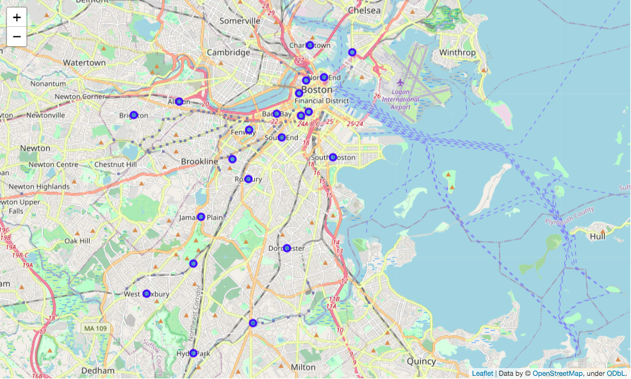

Slide 6
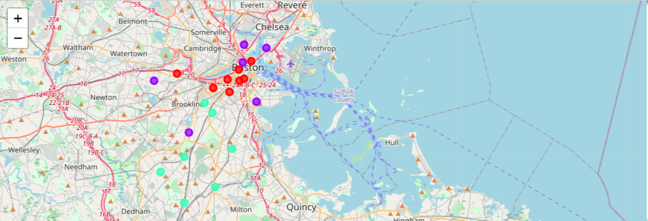

Slide 7
Result
Cluster 0 average housing price: 1067.875
Cluster 1 average housing price: 647
Cluster 2 average housing price: 405

Slide 8
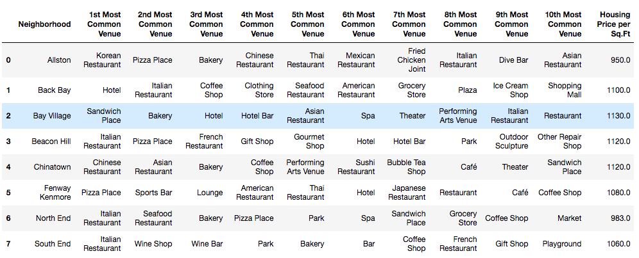
Result-cluster 0

Slide 9
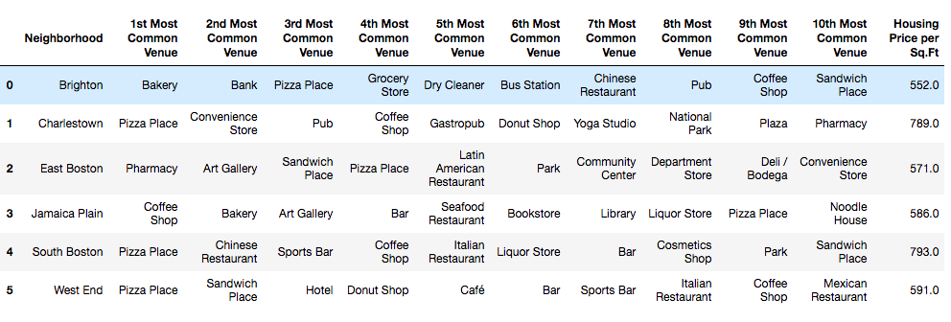
Result-cluster 1

Slide 10
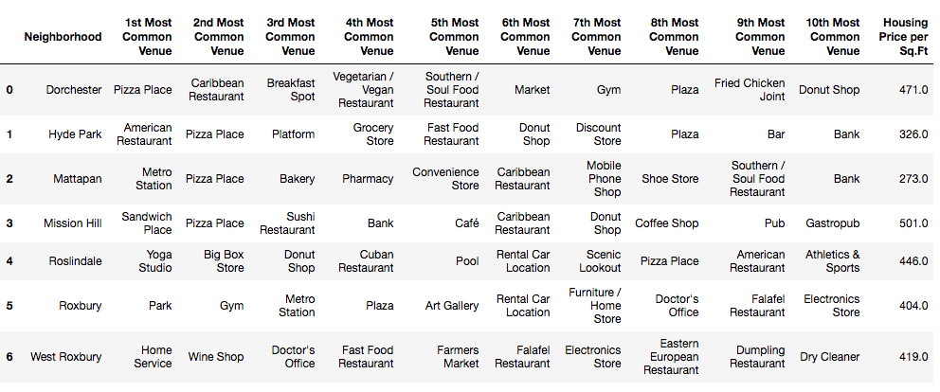
Result-cluster 2

Slide 11
Discussion
The housing price is affected by many other factors other than category of venue. However, by analyzing the category of venue in certain neighborhood, we can definitely get some insights regarding to its housing price.

Slide 12
Conclusion
When a real estate investor want to invest in certain neighborhood, he/she can start analyzing the neighborhood ‘s venue category to gain some insights regard this neighbor. However, the housing price analysis can be completed by adding more other factors such as education recourse, population density to get more accurate result.

